Slide 1
From the History of Refugees to Refugee History
Peter Gatrell
University of Manchester

Slide 2
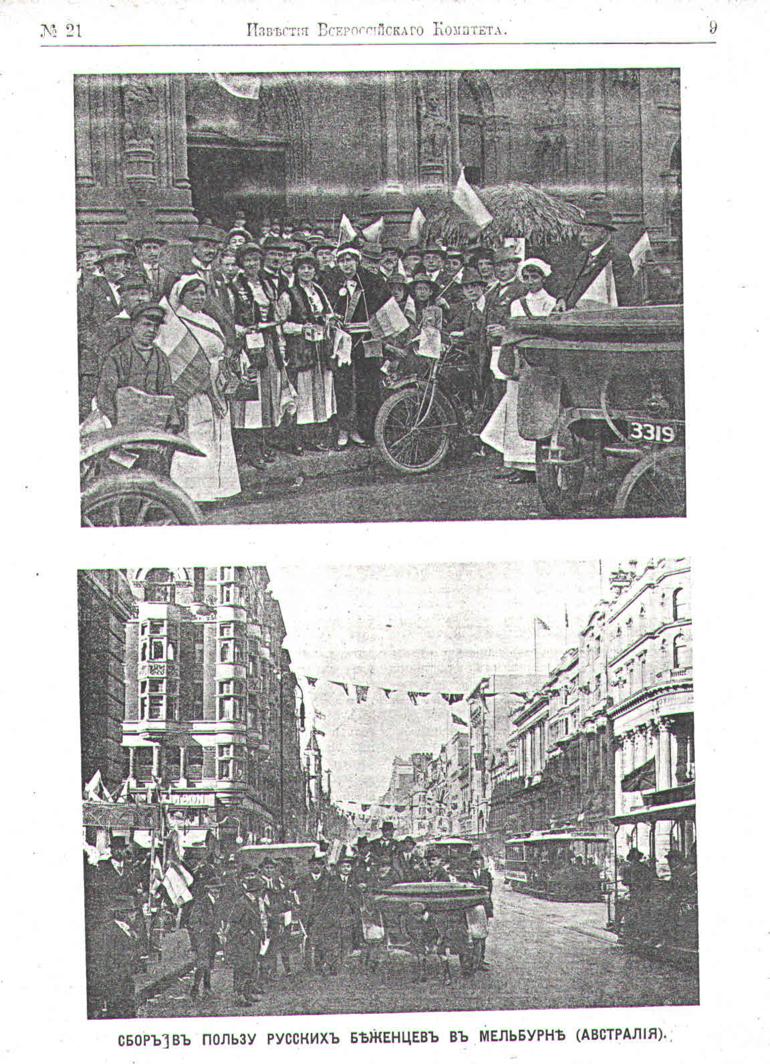
Collecting for Russian refugees, Melbourne, 1915
… an opportunity to think about the causes of ‘causes’
Unknown photographer/date (probably late 1915)
Source: News Bulletin (Izvestiia) of the All-Russian Union of Towns and Zemstvos

Slide 3
Historians and the ‘here and now’
What’s at stake for the historian of refugees, now?
We have a responsibility, inter alia, to:
analyse how and, with what consequences, refugees ‘become’ … become a ‘problem’ amenable to a ‘solution’
challenge the lazy, presentist formula of an ‘unprecedented crisis’ by considering past episodes (the precedents of the ‘unprecedented’, e.g. displacement and ‘problem-solving’ after two world wars)
draw attention to enduring yet neglected situations whose resolution seems remote, e.g. Sahrawi, Rohingya, Palestinian …
challenge European parochialism

Slide 4
History of refugees … refugee history?
Beyond the history/histories of particular instances of mass population displacement, is it possible to map the contours of a ‘refugee history’?
Beyond a history addressing multiple actors, perspectives, encounters, and constraints in specific contexts – is it possible (or desirable) to bring all of this within a single analytic frame?
  My proposal is to incorporate histories of refugees within a broader rubric of ‘refugeedom’, conceived not as a pure abstraction but as a matrix of relations and practices that had concrete effects

Slide 5
Refugee history: advice to a younger self
It’s about refugees, but not just about refugees. Consider the politics around multiple relations:
states (old states, warring states, embryonic and new states)
inter-governmental organisations (purpose; personnel, etc.)
NGOs and aid workers (various histories, ideologies; rivalries); lawyers, private activists
host population (issues around ethnicity and economic status)
other non-refugees: those who stayed (or were left) behind
other refugees, including diasporas (different vintages and politics), and the descendants of refugees
Each relationship discloses mixed (sometimes contradictory and irreconcilable) motives, ideologies, expectations, anxieties, which historians can contextualise and seek to explain

Slide 6
Agenda continued: negotiating other relations
Sites of displacement (camps, holding centres, settlements) … histories of place-making and re-making, e.g. histories of ‘development’
Histories of management and expertise, e.g. around mental health, social work, ‘rehabilitation’
Histories of refugee agency, e.g. everyday resistance, mobilisation of ‘refugee warriors’
Relatedly, refugees as historians of their own predicament (which authors, writing for which audiences?) … representing displacement

Slide 7
Iconography of displacement
Cultural representations over which refugees often have no control
Gendered iconographies of displacement and suffering – recycled images, with recurrent emphasis on anonymous and de-historicised victims; refugees as flotsam and jetsam, to be pitied or feared (or both)

Slide 8
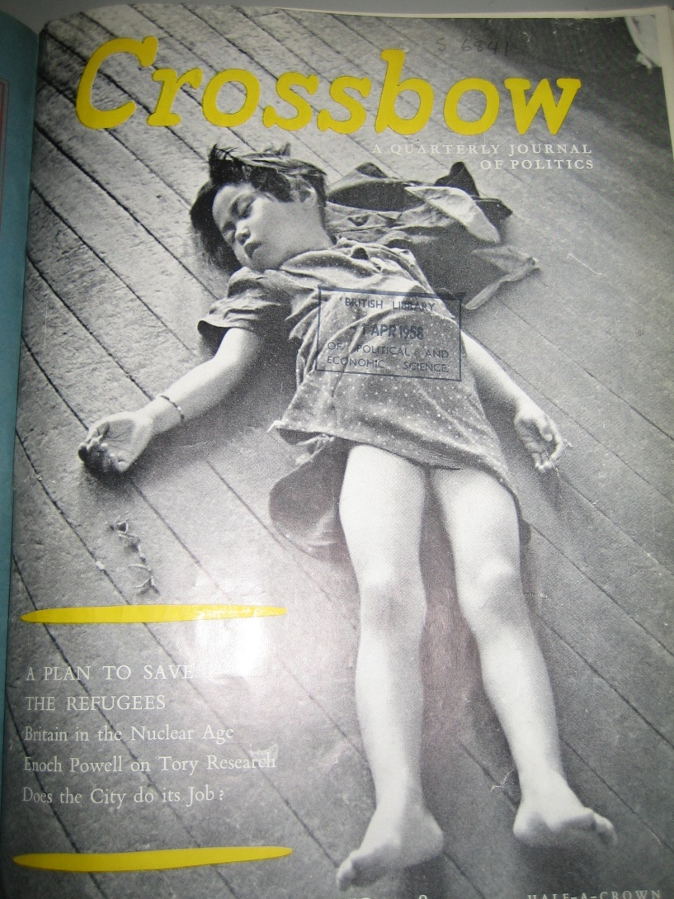
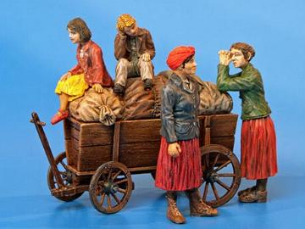
Model refugees?

Slide 9
Refugeedom and its centenary
Origin of term (bezhenstvo) in Russia indicating refugees’ status and ‘condition’, against the backdrop of mass displacement and improvised refugee regime; implication about ‘character’ derived from circumstances
How might historians deploy the term whilst avoiding (a) essentialisation and (b) stasis?
Refugeedom draws attention to asymmetrical power relations, but also invites historians to ask how refugees negotiate(d) the label and the refugee regime in different contexts

Slide 10
Refugee regimes: a history of inclusion and exclusion
Refugee regimes afforded ‘recognition’, and an apparatus of assistance and ‘protection’ – but there is a history and therefore a history of political choices
Selective legal-institutional definition in post-WW1 Europe (Russian and Armenian, not ‘Lausanne’ refugees); selective definition in post-WW2 Europe (e.g. excluded German expellees)
The world beyond Europe (South Asia, Middle East, South-East Asia post-WW2): regional and local regimes were established, and negotiated, often beyond UNHCR’s mandate, again involving inclusion and exclusion … who is a ‘refugee’?

Slide 11
Refugeedom as ‘making up people’
  Pierre Bourdieu spoke of ‘the classification struggle’ (Bourdieu, 1980: 180)
  Ian Hacking refers to 19th century efforts to count, classify and demarcate people, and how this created ‘new ways for people to be’.
  Hacking distinguishes between two ‘vectors’: one is labelling from above, involving the application of expert knowledge, the other from below, reflecting autonomous action by the individual
  (Ian Hacking, ‘Making up People’, The London Review of Books, 17 August 2006)

Slide 12
Categories, labels, and history
  The shifts in categories used to measure migration may be of more significance than the actual numbers themselves. We cannot understand migration without simultaneously understanding the social processes by which they have been produced, recorded, and processed as ‘refugees’, ‘guest labourers’, or ‘illegal aliens’ (McKeown, 2004)

Slide 13
Vernacular labels
Beyond the fundamental yet mutable socio-legal framework, unofficial labelling produced a terminological cornucopia
post-WW1, refugees were sometimes referred to as ‘fugitives’ and ‘Nansenists’
post-1945 Displaced Persons were also known as ‘dislodged’, ‘diseased’, and ‘displeased’ persons …
but of course there were myriad official terms (and therefore distinctions) in use

Slide 14
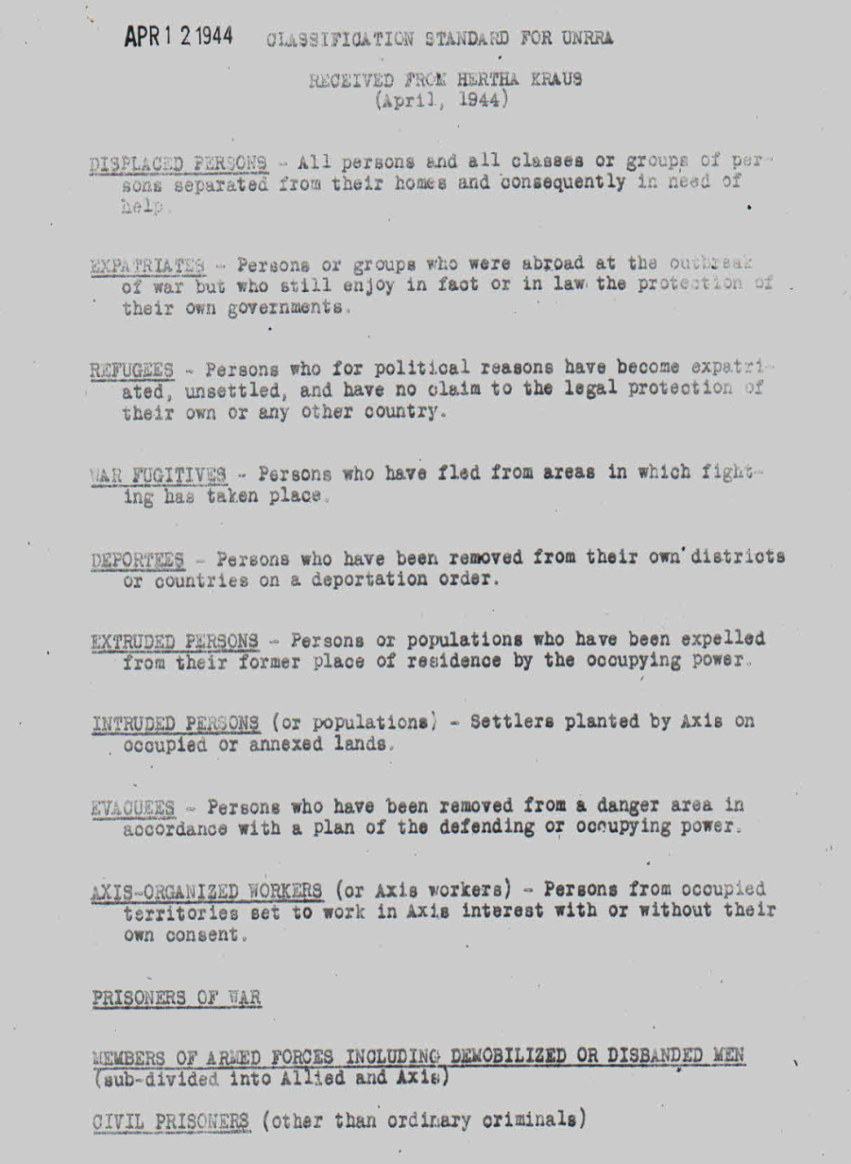
Hertha Kraus, ‘Classification standard for UNRRA’,
April 1944
Displaced Persons
Expatriates
Refugees
War fugitives
Deportees
Extruded persons
Intruded persons
Evacuees
Axis-organised workers
Prisoners of war
Members of armed forces
Civil prisoners

Slide 15
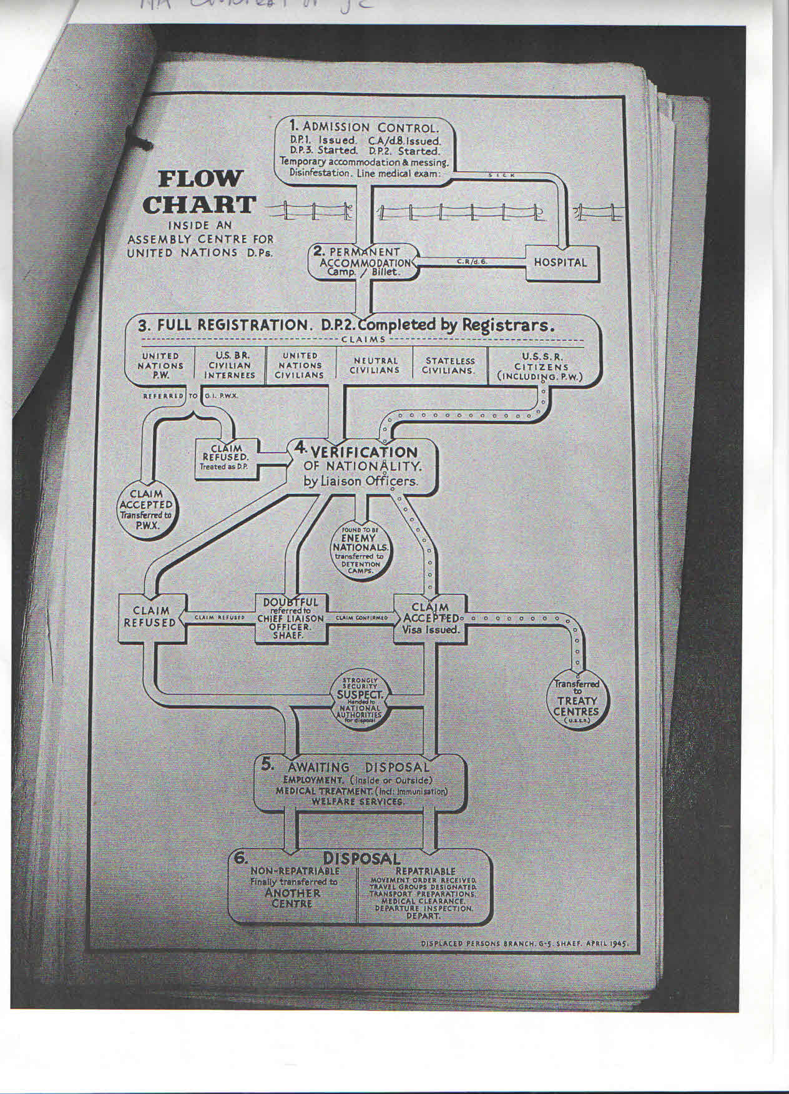
Categories have consequences
  UNRRA ‘flow chart’
  ‘Inside an Assembly Centre for United Nations DPs’ (April 1945) …
  From ‘Admission Control’ via ‘Verification of Nationality’ to ‘Awaiting Disposal’ and ‘Disposal’ (‘repatriable’ or ‘non-repatriable’)
  From UK National Archives, courtesy of Dr Jenny Carson; SHAEF DP Branch

Slide 16
IRO distinctions: refugees coexisted alongside the ‘economic migrant’ and ‘economic dissident’
‘Refugees’ turn up, sometimes in large numbers, at the frontiers of the countries of asylum, and partly in order to secure a more advantageous status and partly, but mainly, to avoid exclusion, seize any favourable opportunity to invoke political reasons as a cloak for their search for a better life’
DPs who refused to repatriate might not be ‘political refugees’, but a new kind of category, of ‘economic dissident’ (Vernant, 1953).

Slide 17
Two versions of ‘refugee’ at mid-century
  ‘For the purposes of the present Convention, the term ‘refugee’ shall apply to any person who … as a result of events occurring [in Europe] before 1 January 1951 and owing to well-founded fear of being persecuted for reasons of race, religion, nationality, membership of a particular social group or political opinion, is outside the country of his nationality and is unable or, owing to such fear, is unwilling to avail himself of the protection of that country’.
UN Refugee Convention, 1951
‘A refugee is a person who has fled or been forced from his home or place of habitual residence under a totalitarian government as a result of war or political, racial, religious or economic oppression, who cannot or fears to return because of the danger of persecution or serious reprisal and who in his country of [temporary] asylum is economically surplus, or unable to achieve permanent residence, or suffers from serious discrimination’
LWF Archives, Elk Grove, Illinois, NLC 5/3/1 Lutheran Resettlement Service, Minutes and Agenda, 1949-53.

Slide 18
Aspects of refugee agency – and wit
Refugees sometimes refused the label (e.g. Partition-era refugees who self-identified as pursharthi, ‘believers in self-help’, not sharanarthi, refugees); but others might turn the label into a business opportunity (e.g. ‘Refugee taxis’, ‘Refugee kebabs’, Cyprus, 1974)
Post-WW2 Estonian DPs coined a new word, ‘Dipiistumine’, to describe loss of connection to the past; but some Lithuanians referred to DPs as Dievo paukšteliai, ‘birds of God’, to entertain the possibility of flight to a better life.
A Russian ‘DP alphabet’ included letter E for ‘ekhat’’ (‘to go … nowhere’), N for ‘no documents’ (net dokumentov), and S for slukhi or ‘rumours’, ‘the most panic-inducing of which travel at 300,000 kilometres per second’.

Slide 19
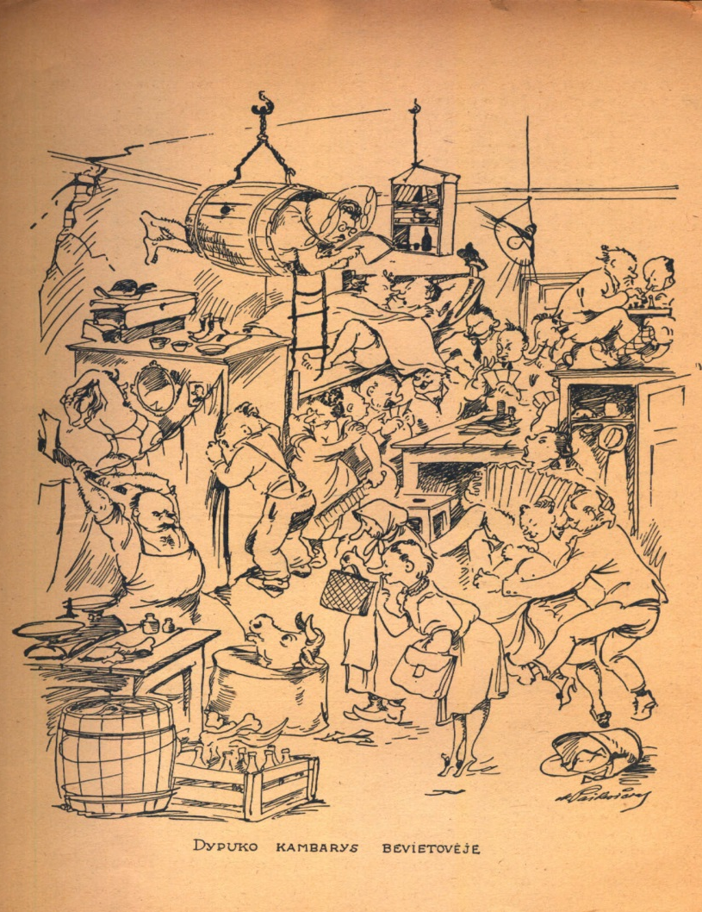
‘DP room in anonymous location’
Lithuanian DP cartoon – note the wealth of ‘types’, ‘housewives’ and the butcher, the professor and chess players, the lovers and the Peeping Tom
Dypukas, 10 August 1946
Courtesy of Tomas Balkelis and Kaunas University

Slide 20
Thinking about sources
Observing and speaking (with authority; with sympathy or otherwise) about refugees – the resulting institutional archives are very rich
Refugees’ voices – the context in which they speak (or are made to speak) or remain silent (or are forced to be silent) … this too has a history (Huguenot refugees were obliged to testify before co-religionists with a reconnaissance ‘obliging each fugitive to become a storyteller’, Chappell, 1999). Petitions as actions disclosing motives, self-representation – how refugees sought to manage their ‘management’ and seek to be believed
Other action, e.g. sewn lips, hunger strikes
Extensive material culture – commemorative objects of refugeedom (memory books, memory boats, etc.) and the underlying political agenda

Slide 21
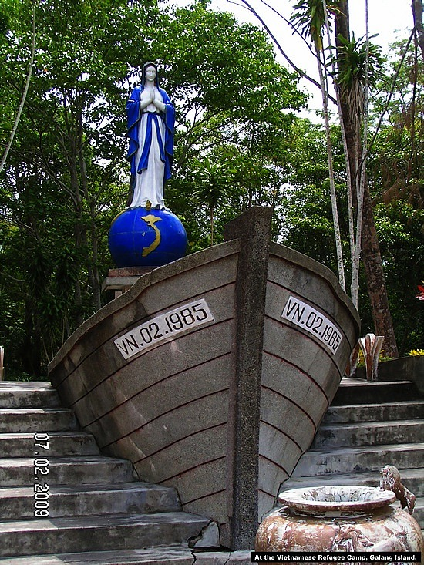
Commemorating deliverance:
Pulau Galang, Indonesia
Notes:
Emphasis on determination – a degree of protection, perhaps – and giving thanks for rescue?

Slide 22
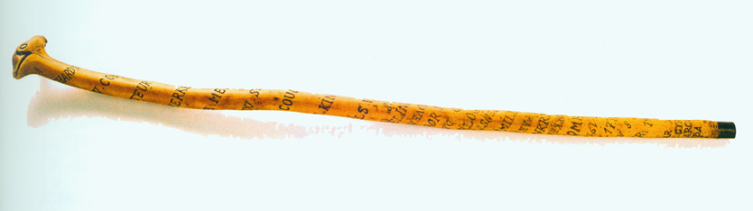
Mr Wybouw’s memory stick
Belgium, WW1:
Richard Wybouw’s engraved walking stick – inscribed with places in northern France
Courtesy of Pieter Trogh,
www.inflandersfields.be
Notes:
Here I am – here I was …

Slide 23
Conclusions: changing places
What do we talk about when we talk of refugees?
Refugee history is about how refugees were made (and made themselves); how they negotiated regimes of power and the reductive assumptions made about their ‘quality’ and uniformity – how they too helped constitute refugeedom
Or we might talk of changing places – as in places that changed, as in exchanging one place and status for another: or starting, stopping, and ‘carrying on’
‘Changing places’ also entails thinking from other disciplinary perspectives …
… and putting oneself in another’s shoes …

Slide 24
‘The souls of the refugee’
Not so long ago, these people lived a full and independent working life. They had the right to be just like us, that is, indolent, rude and ungrateful. Now they have lost this prerogative; their poverty and helplessness oblige them to be meek and grateful, to smile at people they don’t like, to answer each and every question, to submit to the authority of people they don’t respect and have no wish to know …
E. Vystavkina, ‘Ikh dushi’, Sputnik bezhentsa, no. 1, 22-23 September 1915

